Slide 1
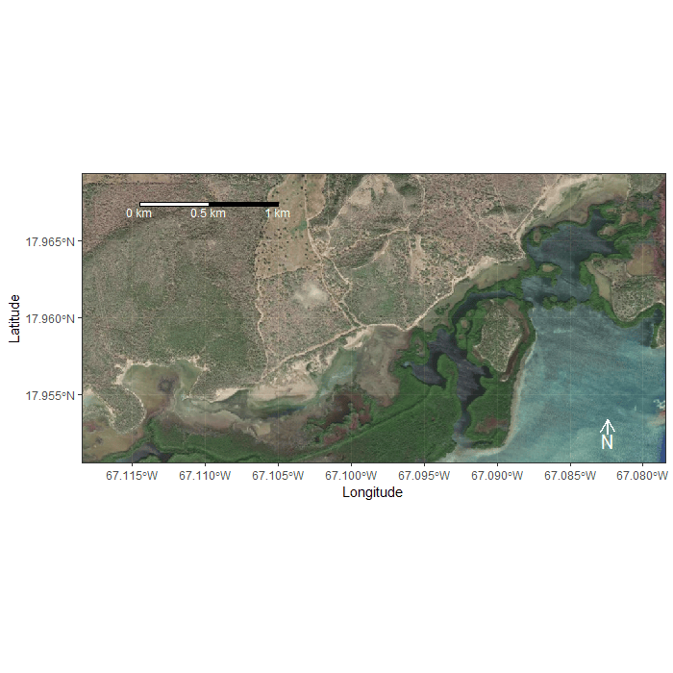
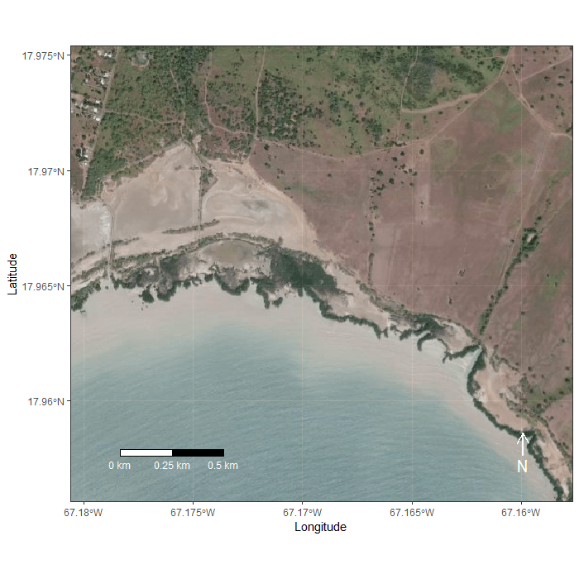
Supplemental Data 1
González-Crespo, J.P., E. Agosto-Torres, R. López-Ortiz, K.R. Ramos-Alvarez, A.R. Puente-Rolón, and M. Quiñones-Rosado 2026. Survival and movement patterns of the Endangered Agelaius xanthomus (Yellow-shouldered Blackbird) during the post-fledging period. Journal of Caribbean Ornithology 39:6–19. https://doi.org/10.55431/jco.2026.39.6-19
Dynamic maps showing the movements of Agelaius xanthomus (Yellow-shouldered Blackbird) fledglings towards communal nocturnal roosts in southwest Puerto Rico during the 2019–2020 breeding seasons. (A) Eastward movements from the Pitahaya Mangrove Forest (38 individuals tracked, 12 shown); (B) westward movements from Bahía Sucia (13 individuals tracked, 1 shown).
A
B

